Slide 1

Proposal to Renovate the Engineering Workspaces at XYZ Company Headquarters
Akshay Govindarajan
Arulmani Paramasivam Kannan
Ashwath Balaji
D. Conor Dykeman
Shreyas Renga Thiruvaranga Raajesh Kanna

Slide 2

Project Objectives
Phase 1: Analyze
Phase 2: Plan
Phase 3: Procure
Phase 4: Implement & Optimize
Critical Success Factors:
Issues and needs clearly addressed
18-month timeline maintained
Day-to-day operations at XYZ are not interrupted

Slide 3
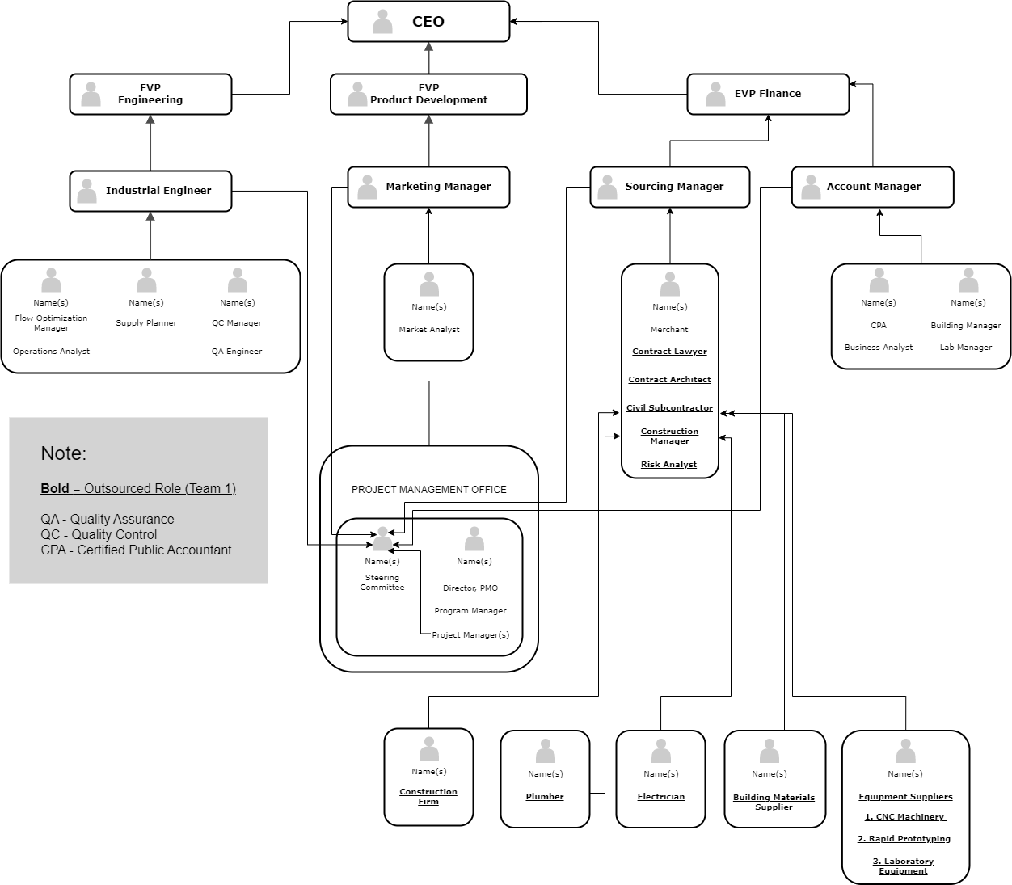
Project Organizational Structures

Slide 4
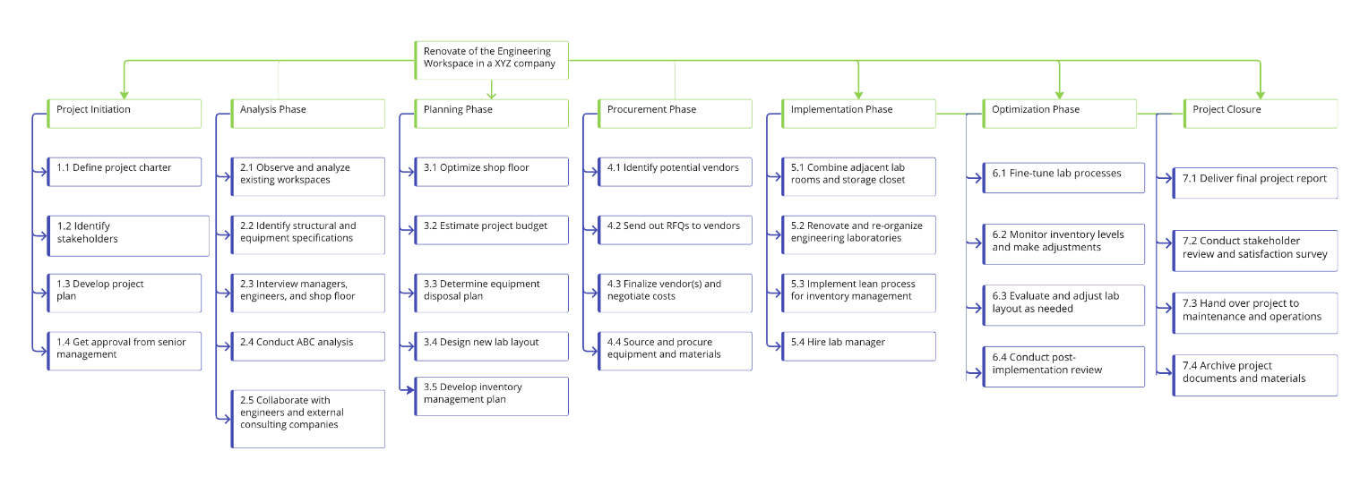
Implementation Plan – Work Breakdown Structure

Slide 5
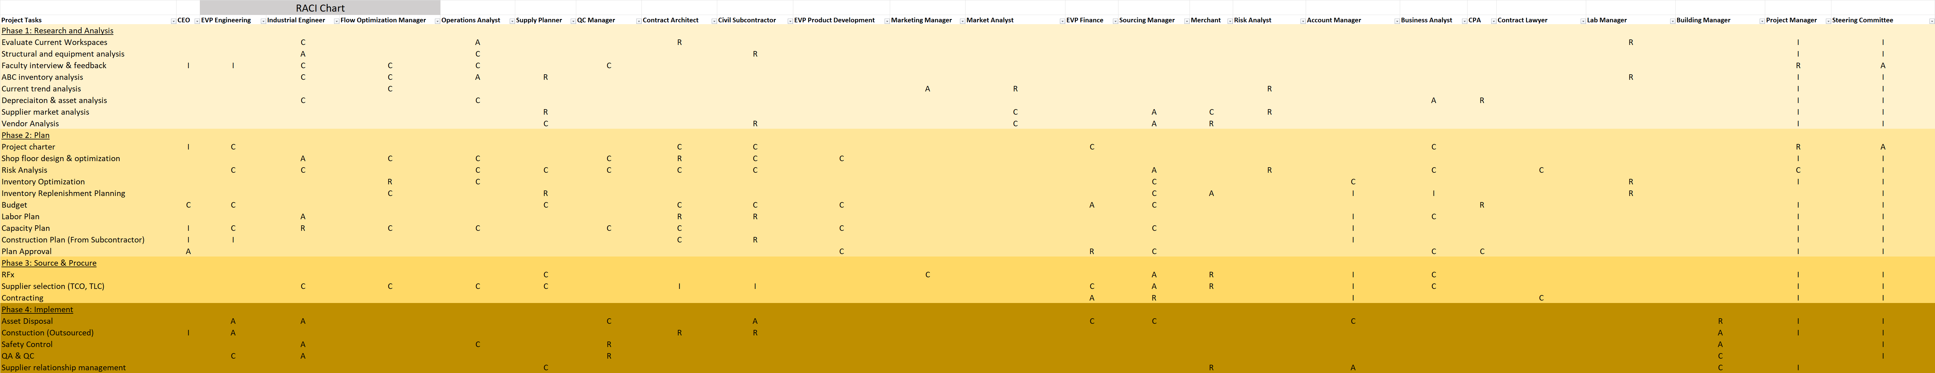
Implementation Plan – RACI Chart
Note: Chart truncated for visibility

Slide 6
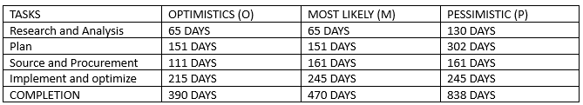
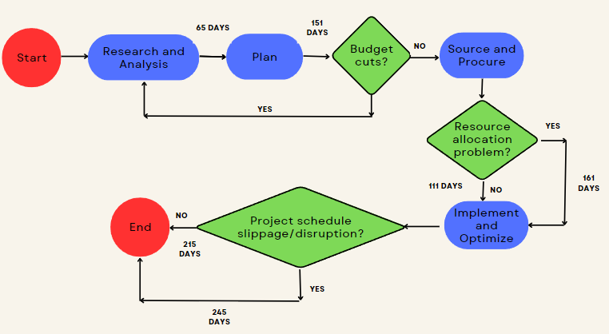
Implementation Plan – PERT Analysis

Slide 7
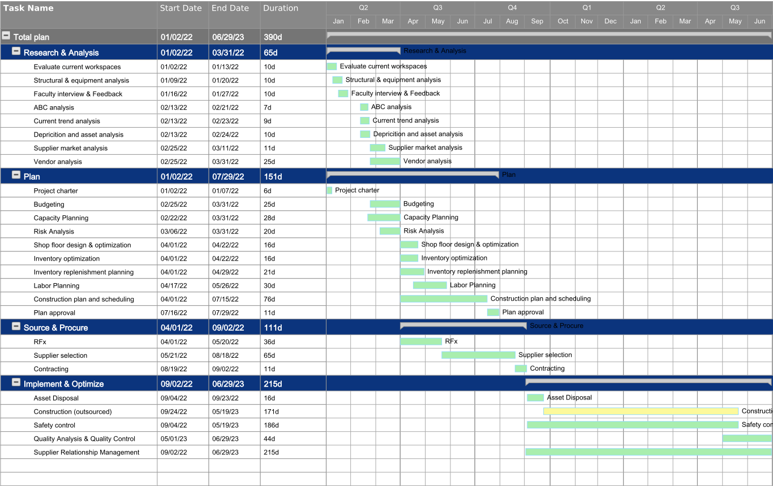
Implementation Plan – GANTT Chart

Slide 8
Risk Analysis – Qualitative & Quantitative Analyses
Top 10 Risks
1. Project schedule slippage
2. Cost creep (labor)
3. Resource allocation – workspace being renovated required sooner/earlier
4. Resource allocation – contractors’ availability
5. Building requirements grandfathered into building code
6. Cost creep (raw materials)
7. Disruption to company day to day business from construction
8. Weather impact on construction
9. Scope creep – company asks for additional capabilities
10. Budget cuts – company decides to lower project scope/cost

Slide 9
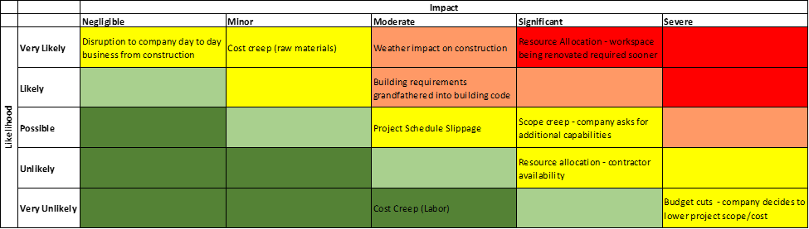
Risk Analysis – Qualitative Analysis
Risk Matrix

Slide 10
Risk Analysis - Quantitative Analysis

Slide 11
Report | Due | Responsible
Progress Report 1 | After completion of demolition and preparation work | Construction Manager
Progress Report 2 | After completion of electrical and plumbing work | Electrical and plumbing contractors
Progress Report 3 | After completion of painting and flooring work | Painting and flooring contractors
Interim Report | After completion of all major renovation work | Project Manager
Progress Report 4 | After completion of furniture and equipment installation | Furniture and equipment installation contractors
Progress Report 5 | After completion of final clean-up and inspection | Quality Control Manager
Final Report | End of the project and handover to the Engineering Department | Project Manager
Monitoring & Control

Slide 12
Financial Plan & Resource Allocation
Total Project Cost
Renovation | $2,000,000
Equipment | $336,000
Project Consultant Costs | $351,000
Allowance for Overages | *1.2
Total Budget | $3,224,400

Slide 13
Conclusion
Remodeling and reorganization of engineering labs at XYZ corporation is crucial for the company's long-term survival amid an ever-growing competitive marketplace
Project aims to develop a cutting-edge lab that adapts to changing demands, encourages creativity and innovation, and fulfills needs of organization and workers
Success factors include excellent communication, cooperation, and flexibility among stakeholders, with continuous monitoring and management.
Benefits include improved efficiency and production, satisfied customer demands, and enhanced employee engagement and satisfaction.

